Slide 1
Jetson OS, OpenCV and TensorRT Installation Guide
2022/06/25
Wade Tsai

Slide 2
Outline
Jetson Platform
Setup OS
Install OpenCV
Linux Desktop
Install CUDA / Cudnn
Install OpenCV with CUDA
Install TensorRT
Setup TensorRT

Slide 3
Jetson Platform – Jetson Nano
Getting Started With Jetson Nano Developer Kit | NVIDIA Developer
使用映像檔安裝 Jetson Nano OS
The Jetson Nano Developer Kit uses a microSD card as a boot device and for main storage
Minimum recommended of microSD card is 32-GB
Write Image to the microSD Card 下載 Jetson Nano Developer Kit SD Card Image
Jetson Nano 的映像擋中就包含CUDA、CUDNN 以及 TensorRT

Slide 4
Jetson Platform – Jetson TX2
安裝Ubuntu 18.04系統 (不能使用虛擬機)
下載 NVIDIA SDK Manager 完成後再terminal輸入 sdkmanager
官方教學 Install Jetson Software with NVIDIA SDK Manager Documentation
開啟 sdkmanager 登入Nvidia帳號，接著刷機至TX2 SD card
Jetson TX2 進入 Recovery Mode:
POWER BUTTON 按一下放開
FORCE RECOVERY持續按著三秒以上不放(三秒後仍然未放開)
接著按RESET BUTTON(FORCE RECOVERY 與 RESET 一起放開)

Slide 5
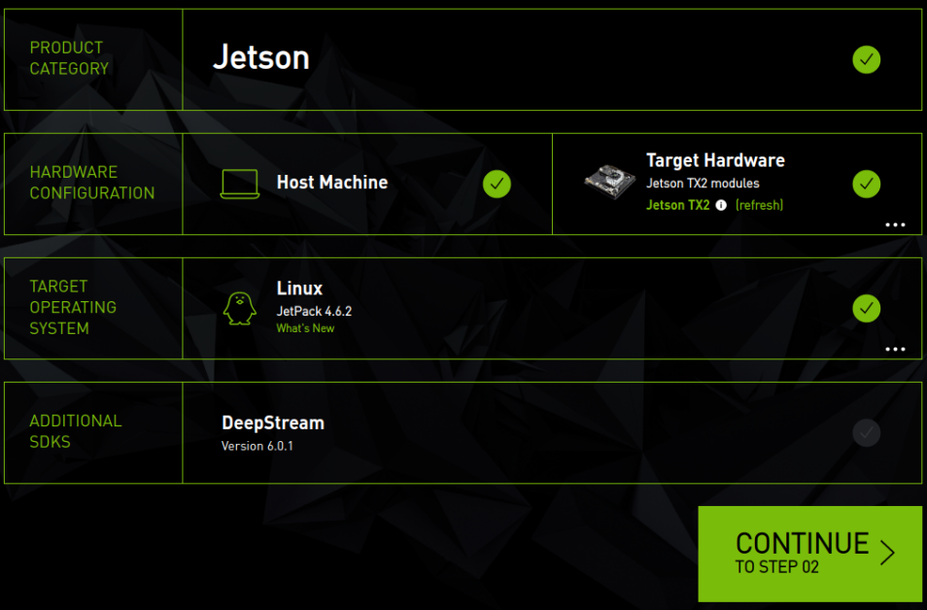
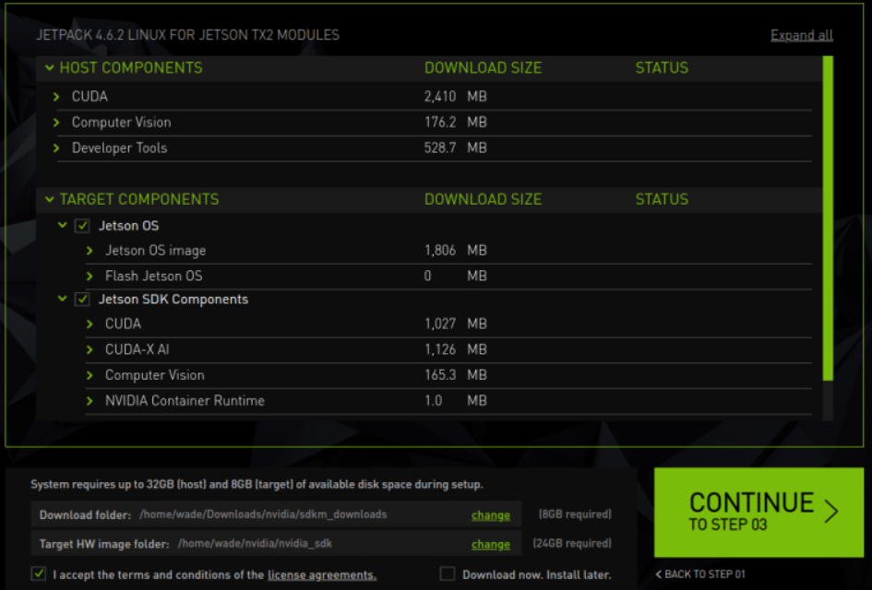
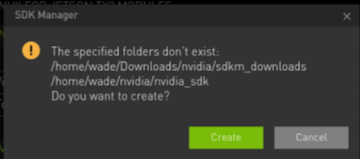
Jetson Platform – Jetson TX2
將 TX2 切為 RECOVERY MODE
透過micro USB 與 TX2連線
確認 Target Hardware 為 Jetson TX2
選擇要存放Jetpack Linux位置
勾選 license agreements
按下Continue等待下載
1.
2.
3.
1.
2.

Slide 6
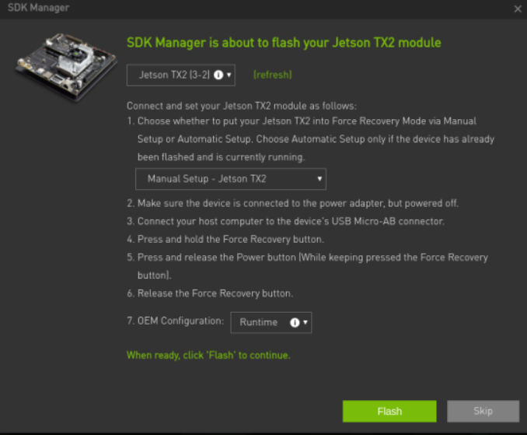
Jetson Platform – Jetson TX2
下載完後接著燒入至TX2
選擇 Manual Setup – Jetson TX2
OEM Configuration 選擇 Runtime
按下 Flash 開始燒入 OS
燒入成功後會出現與Ubuntu系統相同的初始設定介面，設定完後就可以開啟系統

Slide 7
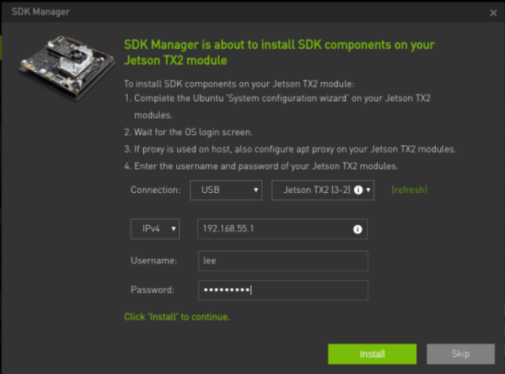
Jetson Platform – Jetson TX2
此步驟必須先設定完 TX2 系統設定
成功燒入OS接著要安裝SDK Components
包含: CUDA、CUDNN 與 TensorRT

Slide 8
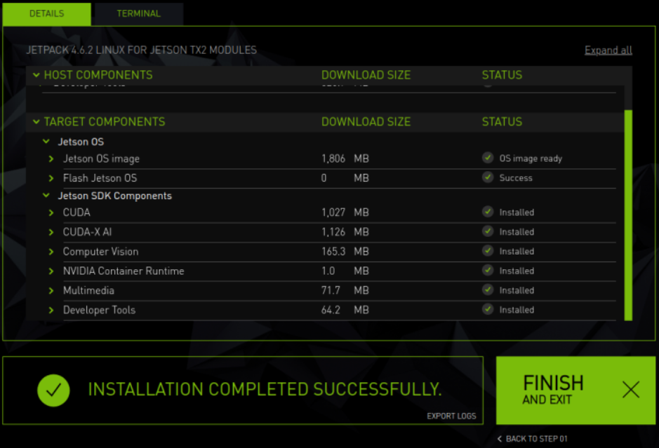
Jetson Platform – Jetson TX2
到此Jetson TX2 系統安裝就完成了

Slide 9
Jetson Platform – Install OpenCV
Jetson Nano 與 Jetson TX2 安裝 OpenCV 流程都一樣，只需要改其中的CUDA_ARCH_BIN
Jetson Nano => 5.3 Jetson TX2 => 6.2
更新及下載 OpenCV 4.5.5
sudo apt-get update
sudo apt-get upgrade
cd ~
wget -O opencv.zip https://github.com/opencv/opencv/archive/4.5.5.zip
wget -O opencv_contrib.zip https://github.com/opencv/opencv_contrib/archive/4.5.5.zip
unzip opencv.zip unzip opencv_contrib.zip
mv opencv-4.5.5 opencv mv opencv_contrib-4.5.5 opencv_contrib

Slide 10
Jetson Platform – Install OpenCV
2. 安裝相關套件
sudo apt-get install -y build-essential cmake git unzip pkg-config zlib1g-dev libjpeg-dev libjpeg8-dev libjpeg-turbo8-dev
sudo apt-get install -y libpng-dev libtiff-dev libglew-dev libavcodec-dev libavformat-dev libswscale-dev
sudo apt-get install -y libgtk2.0-dev libgtk-3-dev libcanberra-gtk*
sudo apt-get install -y python-dev python-numpy python-pip python3-dev python3-numpy python3-pip
sudo apt-get install -y libxvidcore-dev libx264-dev libgtk-3-dev
sudo apt-get install -y libtbb2 libtbb-dev libdc1394-22-dev libxine2-dev
sudo apt-get install -y gstreamer1.0-tools libgstreamer-plugins-base1.0-dev
sudo apt-get install -y libgstreamer-plugins-good1.0-dev
sudo apt-get install -y libv4l-dev v4l-utils v4l2ucp qv4l2
sudo apt-get install -y libtesseract-dev libxine2-dev libpostproc-dev
sudo apt-get install -y libavresample-dev libvorbis-dev
sudo apt-get install -y libfaac-dev libmp3lame-dev libtheora-dev
sudo apt-get install -y libopencore-amrnb-dev libopencore-amrwb-dev
sudo apt-get install -y libopenblas-dev libatlas-base-dev libblas-dev
sudo apt-get install -y liblapack-dev liblapacke-dev libeigen3-dev gfortran
sudo apt-get install -y libhdf5-dev libprotobuf-dev protobuf-compiler
sudo apt-get install -y libgoogle-glog-dev libgflags-dev

Slide 11
Jetson Platform – Install OpenCV
Jetson Nano => 5.3
Jetson TX2 = 6.2
3. Build Make for OpenCV
cmake -D CMAKE_BUILD_TYPE=RELEASE \
-D CMAKE_INSTALL_PREFIX=/usr \
-D OPENCV_EXTRA_MODULES_PATH=~/opencv_contrib/modules \
-D EIGEN_INCLUDE_PATH=/usr/include/eigen3 \
-D WITH_OPENCL=OFF \
-D WITH_CUDA=ON \
-D CUDA_ARCH_BIN=5.3 \
-D CUDA_ARCH_PTX="" \
-D WITH_CUDNN=ON \
-D WITH_CUBLAS=ON \
-D ENABLE_FAST_MATH=ON \
-D CUDA_FAST_MATH=ON \
-D OPENCV_DNN_CUDA=ON \
-D ENABLE_NEON=ON \
-D WITH_QT=OFF \
-D WITH_OPENMP=ON \
-D BUILD_TIFF=ON \
-D WITH_FFMPEG=ON \
-D WITH_GSTREAMER=ON \
-D WITH_TBB=ON \
-D BUILD_TBB=ON \
-D BUILD_TESTS=OFF \
-D WITH_EIGEN=ON \
-D WITH_V4L=ON \
-D WITH_LIBV4L=ON \
-D OPENCV_ENABLE_NONFREE=ON \
-D INSTALL_C_EXAMPLES=OFF \
-D INSTALL_PYTHON_EXAMPLES=OFF \
-D PYTHON3_PACKAGES_PATH=/usr/lib/python3/dist-packages \
-D OPENCV_GENERATE_PKGCONFIG=ON \
-D BUILD_EXAMPLES=OFF ..
3.1 在OpenCV內建立build資料夾
3.2 使用cmake 建立
cd ~/opencv
mkdir build
cd build
查看Nvidia GPU CUDA Level
GPU CUDA Supported Level

Slide 12
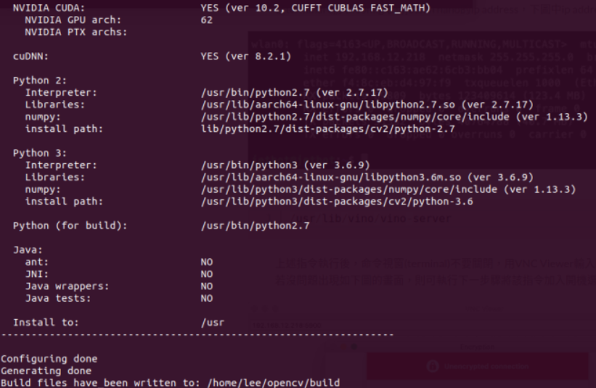
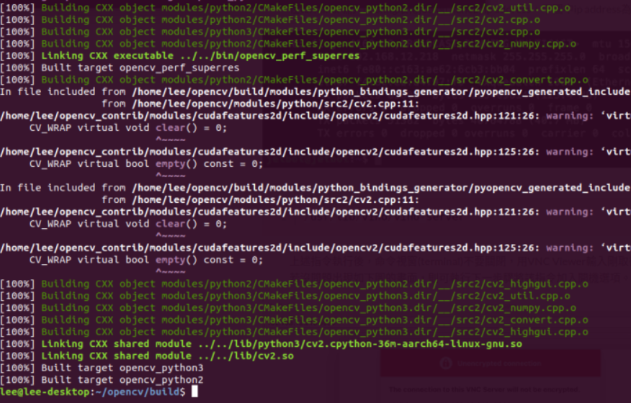
Jetson Platform – Install OpenCV
Cmake參數配置完成如下圖
接著執行
make -j4
建構完後會出現如下圖

Slide 13
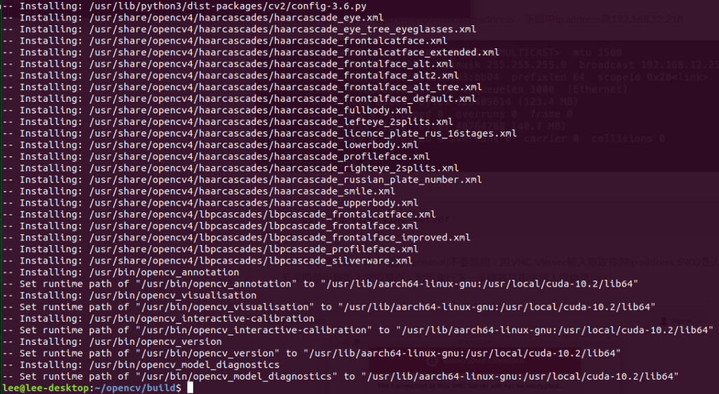
Jetson Platform – Install OpenCV
sudo rm –r /usr/include/opencv4/opencv2
sudo make install
sudo ldconfig
make clean
完成後出現與右圖結果相同表示安裝成功

Slide 14
Setup TensorRT
後續安裝、啟動都是參照以下網站:
jkjung-avt/tensorrt_demos: TensorRT MODNet, YOLOv4, YOLOv3, SSD, MTCNN, and GoogLeNet (github.com)
Jetson platform 與 Linux desktop 啟動步驟都相同
1. Clone tensorrt_demo repository
git clone https://github.com/jkjung-avt/tensorrt_demos.git
2. Install pycuda
cd tensorrt_demos/yolo
./install_pycuda.sh
3. Install version 1.9.0 of python3 onnx module
sudo pip3 install onnx==1.9.0
4. Build yolo_layer plugin
cd tensorrt_demos/plugins
make
5. Download pre-train models
cd tensorrt_demos/yolo
./download_yolo.sh
python3 yolo_to_onnx.py -m yolov4-416
python3 onnx_to_tensorrt.py -m yolov4-416

Slide 15
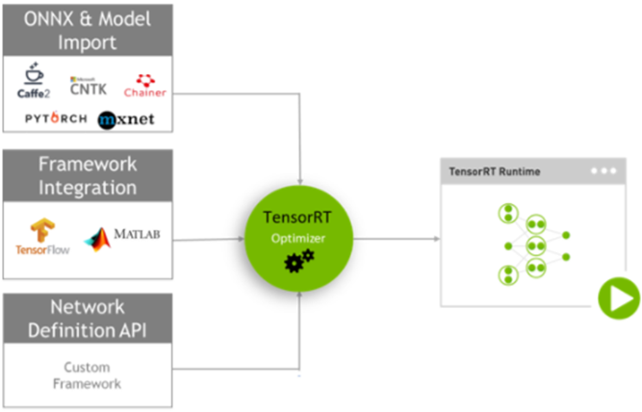
TensorRT
高效能的深度學習推理平臺
ONNX
TensorFlow
Caffe
Python API
C++ API
MATLAB

Slide 16
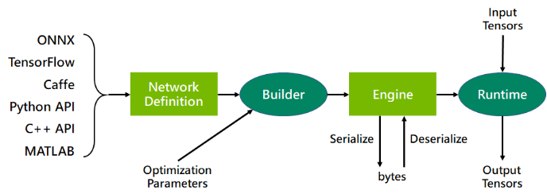
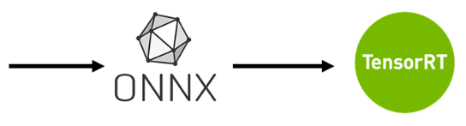
TensorRT
YoloV4

Slide 17
參考資料
[1] Getting Started With Jetson Nano Developer Kit | NVIDIA Developer
[2] Install OpenCV 4.5 on Jetson Nano - Q-engineering (qengineering.eu)

